Slide 1
The most FAQ
Question: Coach, do you know what are rankings are?
Short Answer: Yes, I do.
Long Answer: We want you focusing on being the best player you can possibly be. If you are worrying about how each score, each shot will affect your ranking on the team, you are not focusing on the moment at hand.
Control the things you can control
Encouraging your teammates to do their best will force you to raise your level of compete to match theirs and ultimately we become a better team
We take our job as coaches seriously. You need to take your job seriously and play your best every time.
A perfect scenerio is to have 20+ kids playing their hearts out and fighting for a spot in our top 5, top 10, district team, making our jobs as coaches more difficult to set the squads for District, Regional, State competitions.
That in team competition helps the team reach its goals.

Slide 2
What's my Rank
Every time you play 9 or 18 holes for the team, your scores are added to our data base.
We determine your stroke average based on the following formula.
35% Qualifying round Scoring Average
50% Tournament round Scoring Average
15% Citizenship (72 is great!!) (80, you may need to rethink your life......)
It is vital that all players understand that their scores count, every time you tee it up.
The calculator in the Excell spreadsheet cannot determine what side of the bed you woke up on each morning, all it knows is numbers.
NUMBERS don’t lie.
Play the best you can play, every single time you tee it up.

Slide 3
Highlanders Protect the Field
One of the most valuable lessons that a golfer can learn is the ability to hold themselves as well as other golfers accountable for their actions.
What this means: The scores we shoot are the scores we shoot.
Too many times in the world of golf, players who may feel various family, team, society pressures feel the need to post or attempt to post scores that are not an accurate reflection on what they actually accomplished on the golf course.
It is your responsibility to hold players in your group accountable for their scores.
We can learn do this in an appropriate way to let players know they must be accountable.
Our team goals depend on us knowing beyond a doubt who our best 5 players, next 5 players are.
Our team goals depend on all players in every event "Protecting the field"
We will not Cheat.
We will not allow others to Cheat.

Slide 4
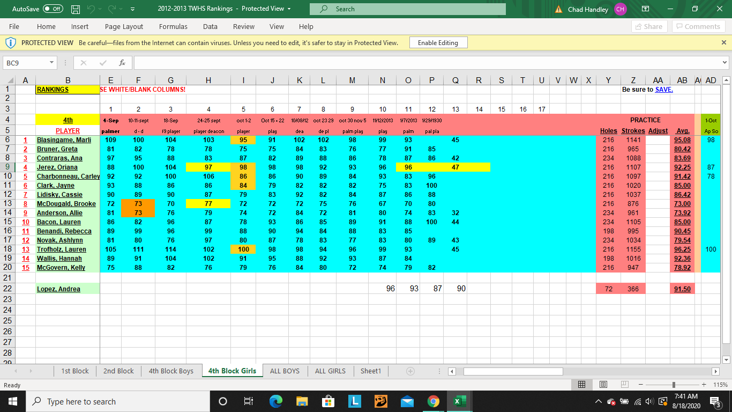

Slide 5
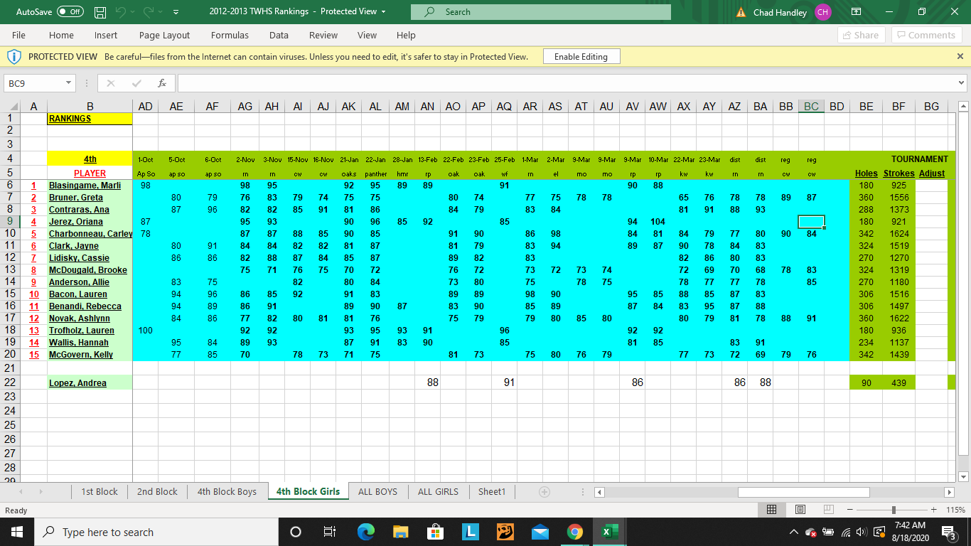

Slide 6
