Slide 1
Physicals and Parent Signatures Paperwork
Please go to the following sites for all the information you need.
https://twhs.conroeisd.net/athletics/
Swol123.net
This all needs to be completed prior to any athletic participation.

Slide 2
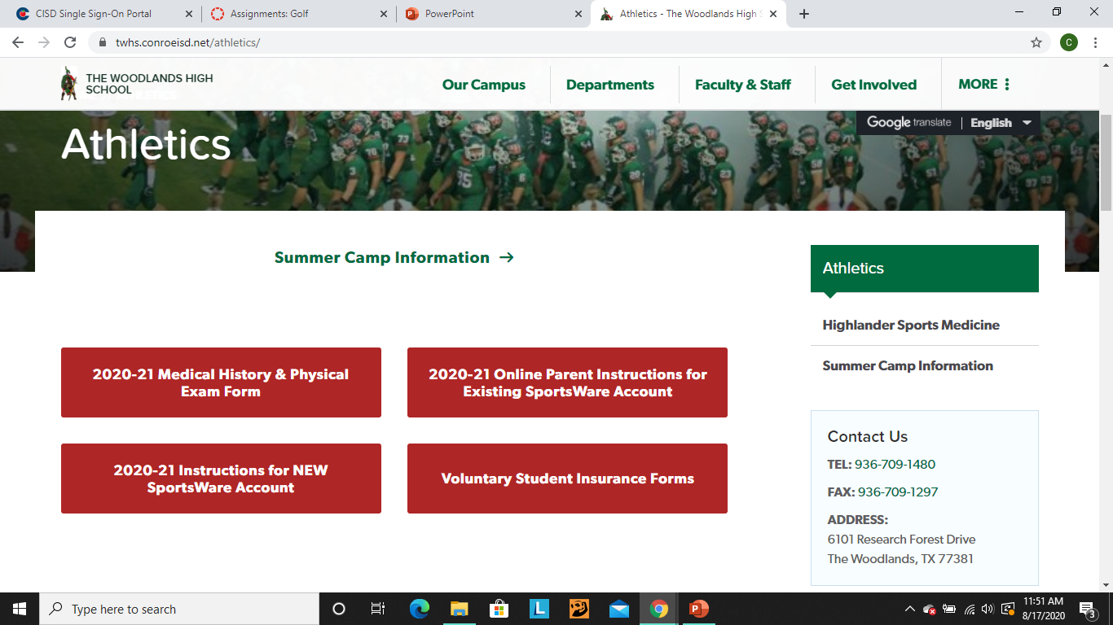
Paperwork – Main Athletic Screen

Slide 3
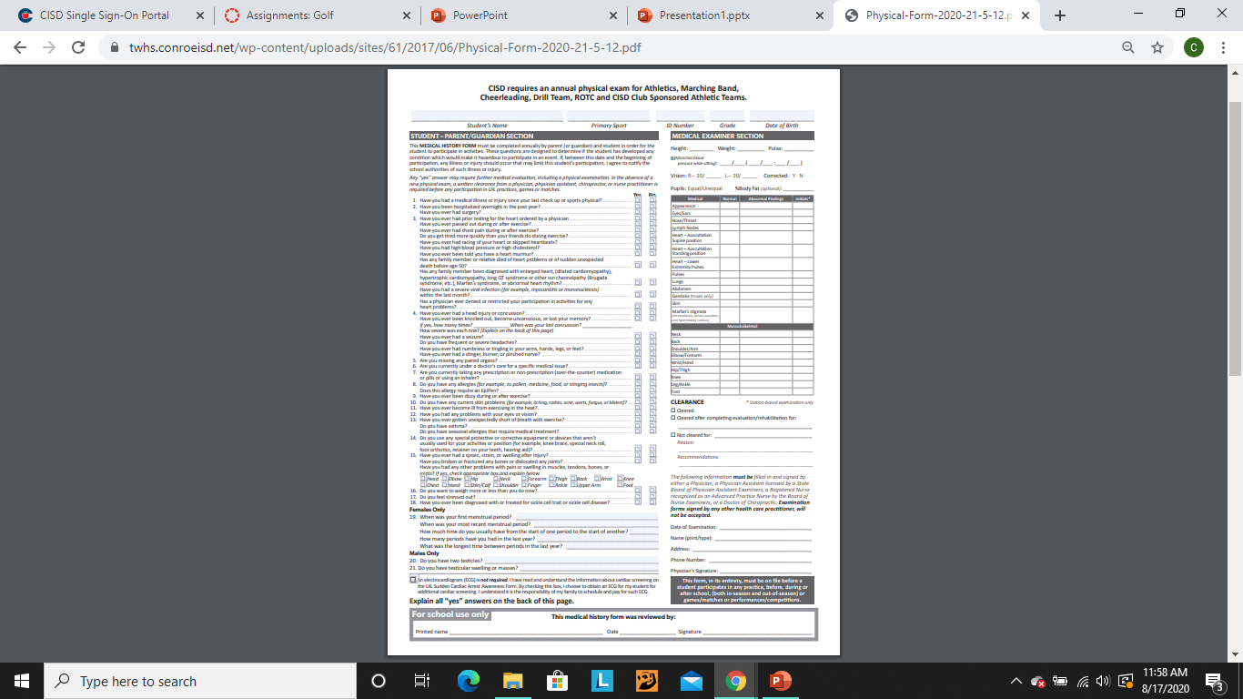
2020-2021 Physical Form

Slide 4
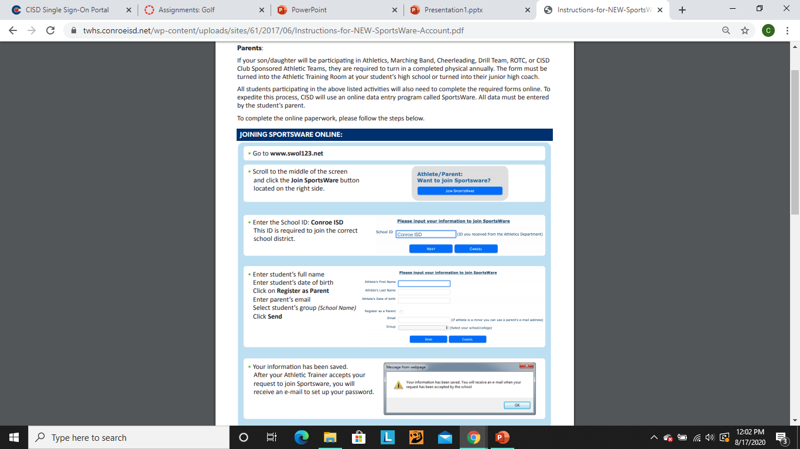

Slide 5
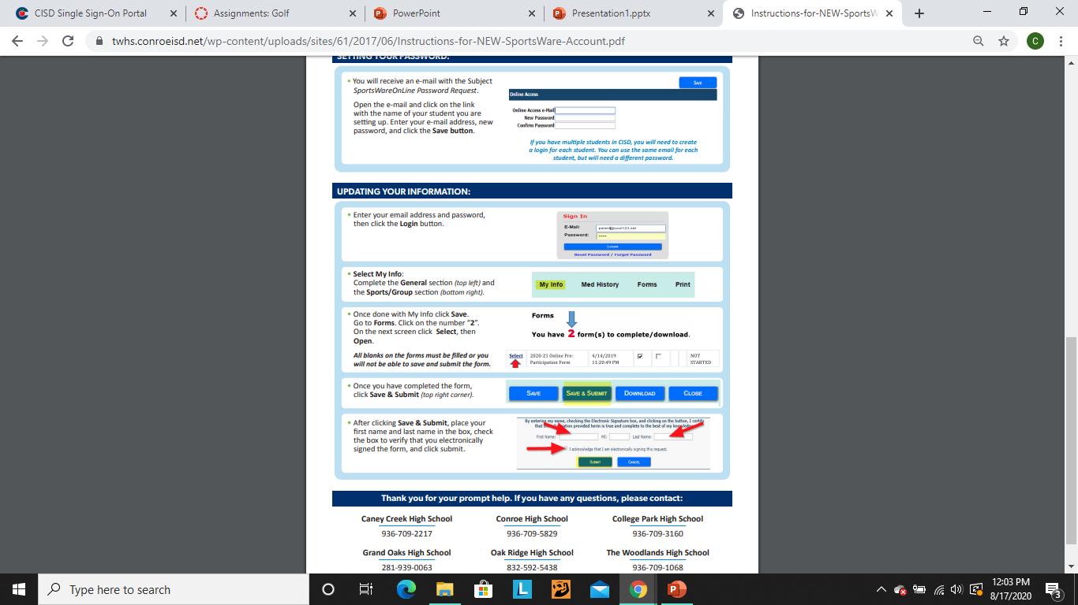

Slide 6
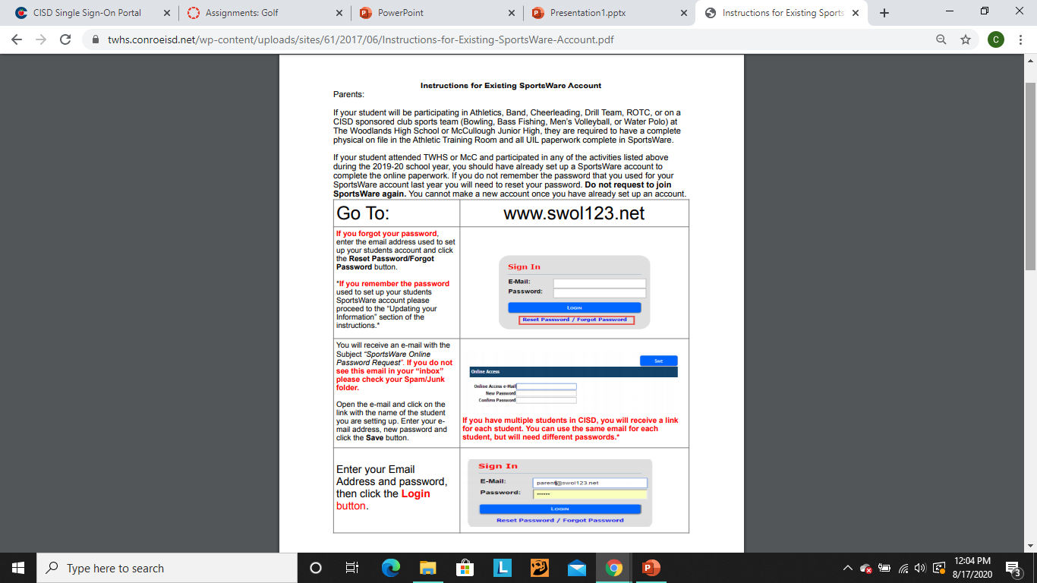

Slide 7
